Slide 1
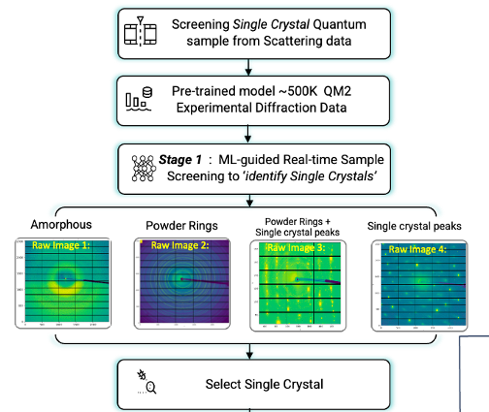
A Scalable Workflow for Curating and Classifying Diffraction Images
Large single-crystal databases contain ~huge number of high-quality diffraction images → manual curation is no longer feasible
Current infrastructure at CHESS GPU enables scalable analysis: existing methods rely on pixel-based embeddings → direct comparison of raw pixel values rather than learned features limits performance
Goal:
Automate labeling and classification of large diffraction datasets using machine learning
Adopt a supervised learning workflow:
Train neural networks on a curated set of pre-labeled diffraction images
The trained classifier will assign images to diffraction
Application:
Automated, high-throughput analysis of diffraction data

